Slide 1

Final Project
Retail-Forecasting for a Large Beverage Company
by
Chenxin Shen
Gloria Jepkurui
Nuzat Siddiqua
14-09-2024

Slide 2
Problem Statement
The project aims to create multivariate forecasting models using AI/ML to anticipate weekly beverage demand at the item level. The organization presently employs an internal software program, but it has trouble managing the different time series patterns in the data that are impacted by trends, seasonality, and holidays. The goal is to replace this approach with parallel-operating, more accurate and efficient ML/Deep Learning models that provide insights into variable contributions for explainability, ideally with PySpark.

Slide 3
EDA
General Analysis for all products
What is the seasonal pattern of average monthly sales, and how does seasonality influence product demand?
How do different promotion strategies (In-Store, Catalogue, and Store End) influence sales performance?
What is the impact of covid/non-covid time on sales and how do sales trends differ during holiday periods compared to non-holiday periods on sales ?
What are the average monthly sales per product?
What are each products sales overtime and the impacts of price discount on sales.

Slide 4
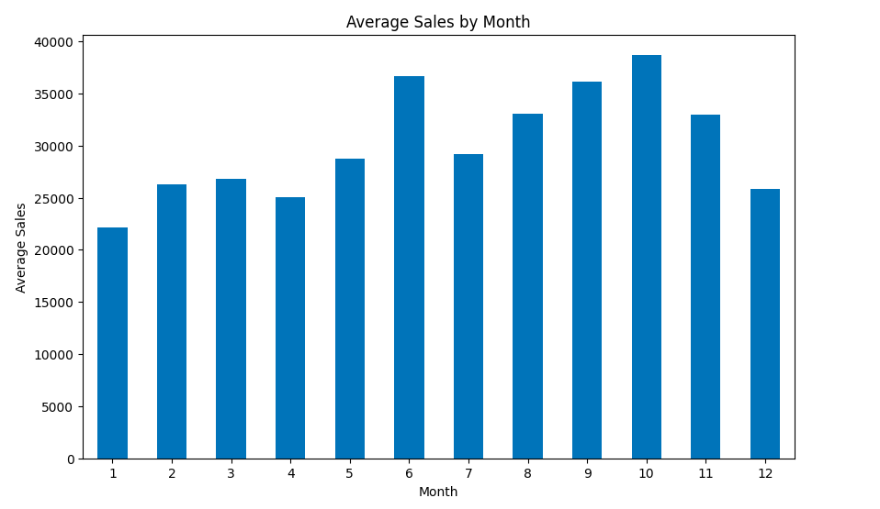
1. What is the seasonal pattern of average monthly sales, and how does seasonality influence product demand?
Sales are highest in June (Month 6) and October (Month 10), indicating strong demand during mid-year and pre-holiday periods. The sales peaks in June and October may be driven by specific holiday seasons or promotional campaigns. There is a noticeable dip in December (Month 12) despite the holiday season, which could suggest the need for more focused promotions or inventory adjustments during this time.

Slide 5
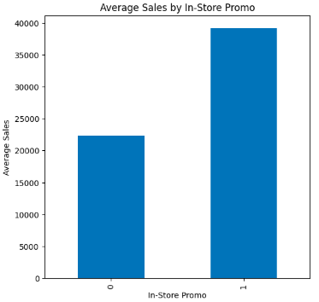
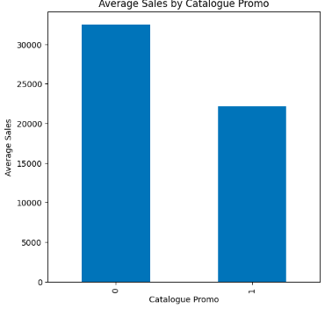
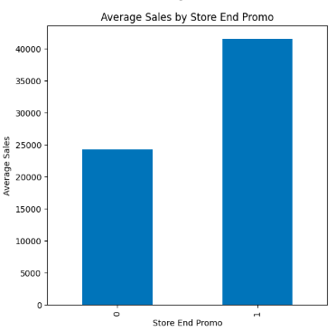
2. How do different promotion strategies (In-Store, Catalogue, and Store End) influence sales performance?
In-store and store end promotions are highly effective strategies for boosting sales, while catalogue promotions seem to have a more neutral or even negative impact on sales performance. The company should focus more on physical, in-store promotional strategies to drive demand.

Slide 6
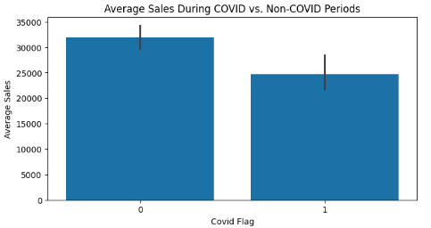
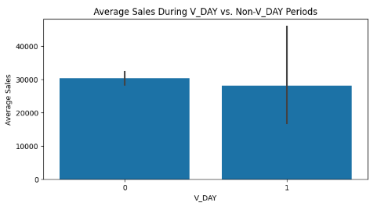
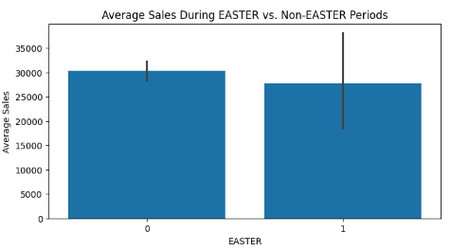
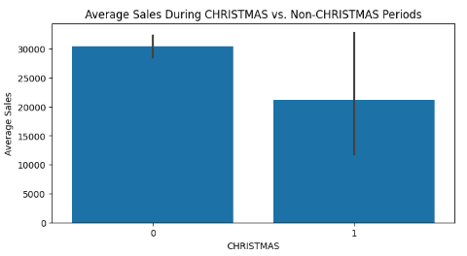
3. What is the impact of covid/non-covid time on sales and how do sales trends differ during holiday periods compared to non-holiday periods on sales ?
COVID seems to have a negative impact on sales, likely due to restrictions, changes in consumer behavior, or disruptions in supply chains.
Overall, holiday periods show no significant positive impact on sales compared to non-holiday periods.
The negative trend during Christmas could suggest that customers may purchase well in advance or opt for alternatives.

Slide 7
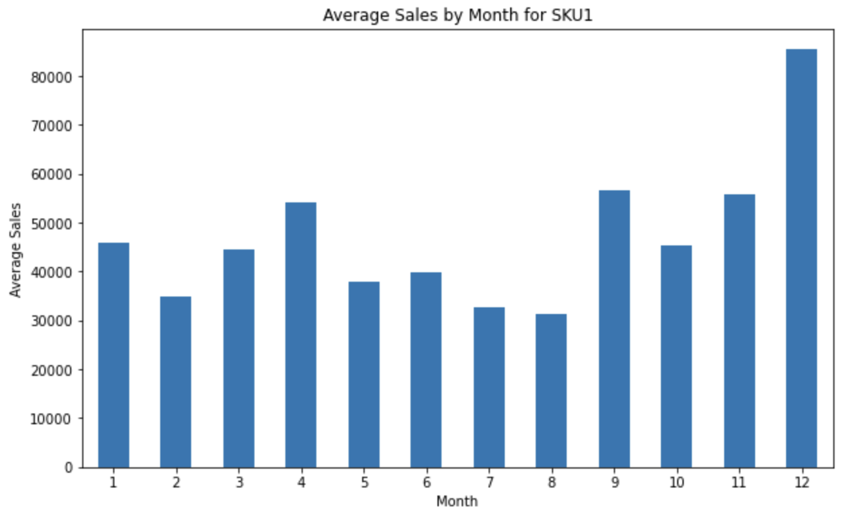
Average monthly sales per product
SKU1 Monthly Average Sales
The Average sales of SKU1 fluctuates throughout the year, in november and december the sales are high; this could be influenced by high demand or other factors like promotions or the festive season.

Slide 8
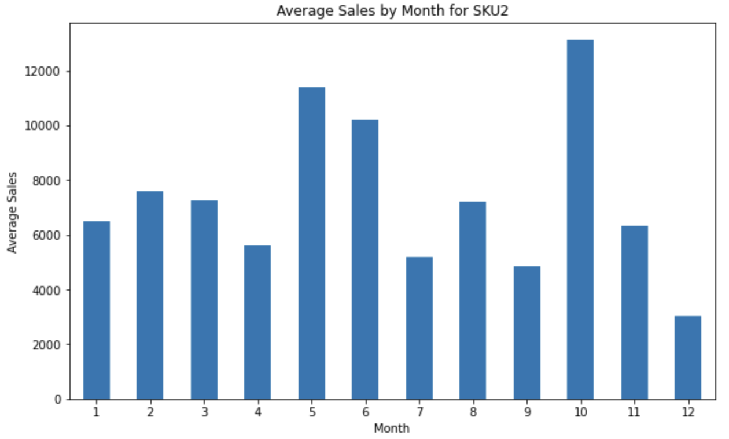
SKU2 Monthly Average Sales
The average sales of Sku2 are high in october, may and june indicating the high product demand in those months and the lowest in december.

Slide 9
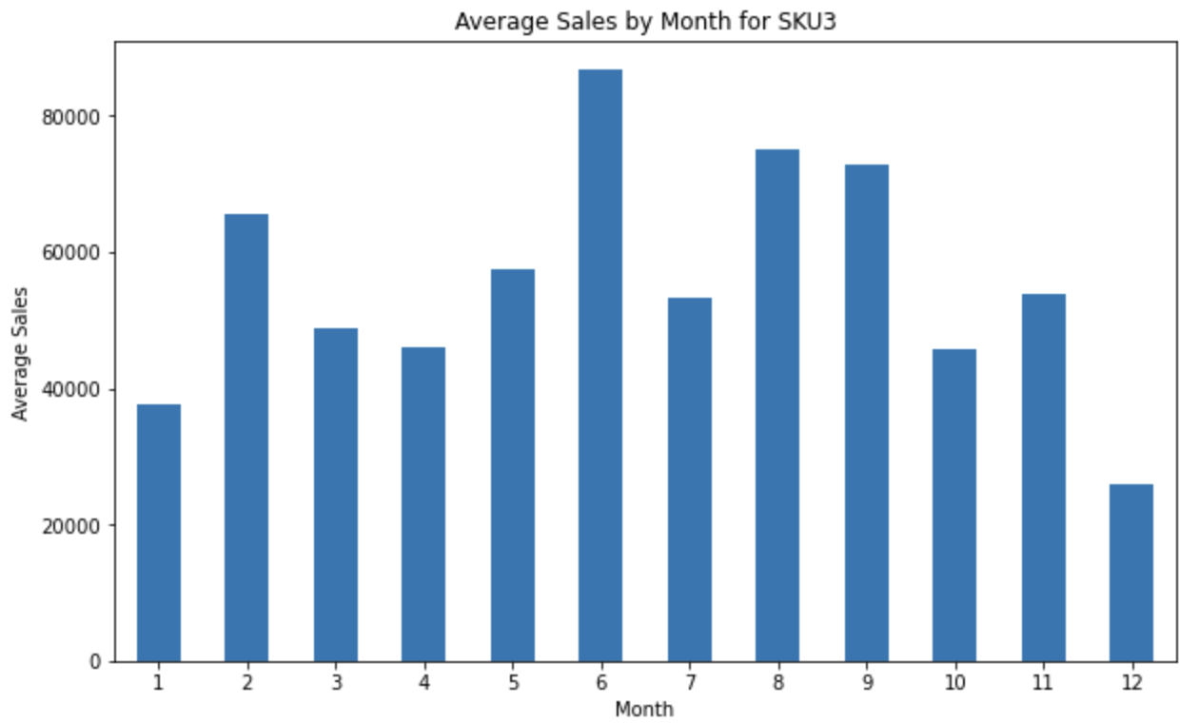
SKU3 Monthly Average Sales
Sku3 sales well throughout the year, some months performing well than the others; for instance june, august, september and february the product’s demand is high and quite low in december. This demand could be influenced by some factors like seasonality.

Slide 10
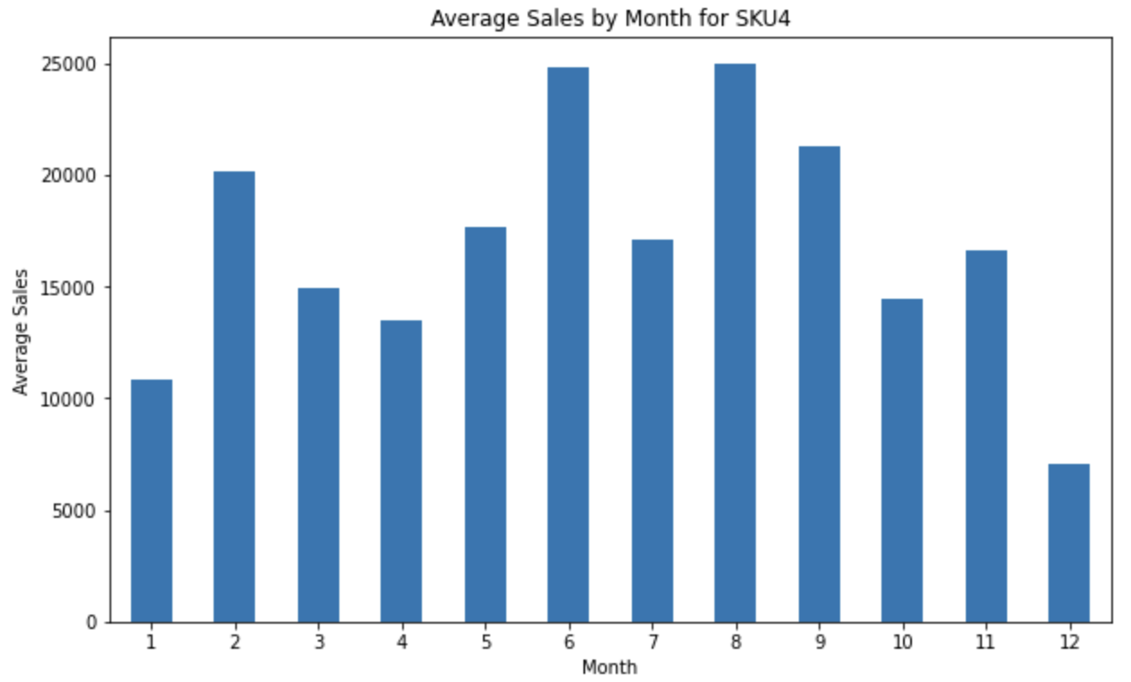
SKU4 Monthly Average Sales
Sku4 sales is high in june august, september and february, and low in december and january. Due to the trend and sales distribution , the products sales are likely affected by seasonality.

Slide 11
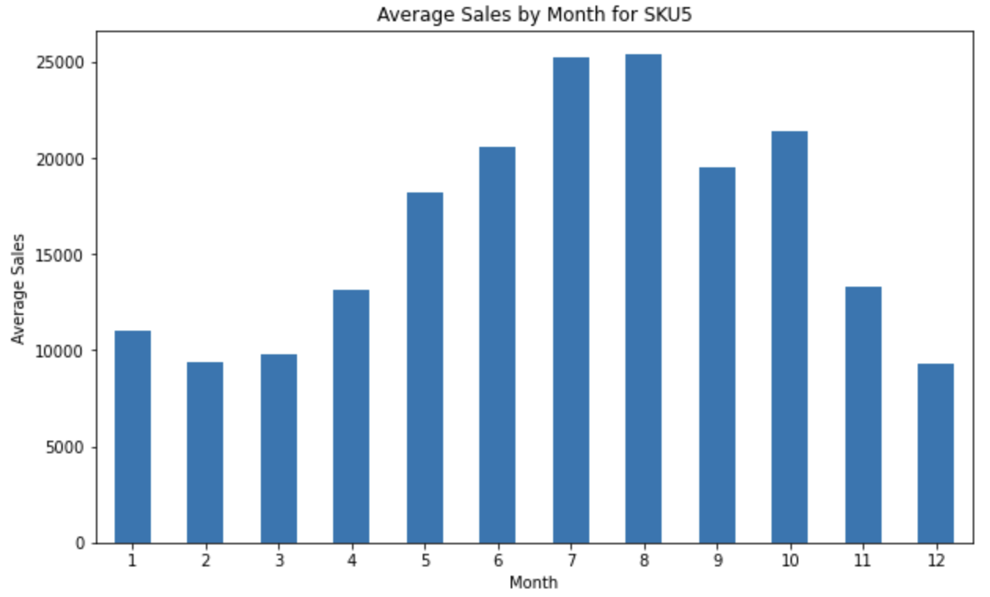
Sku5 Monthly Average Sales
The sales starts going up in may and is at the peak in july and august then it starts dropping in september. This shows a pattern in SKU5 sales and that the product demand is influenced by seasonality.

Slide 12
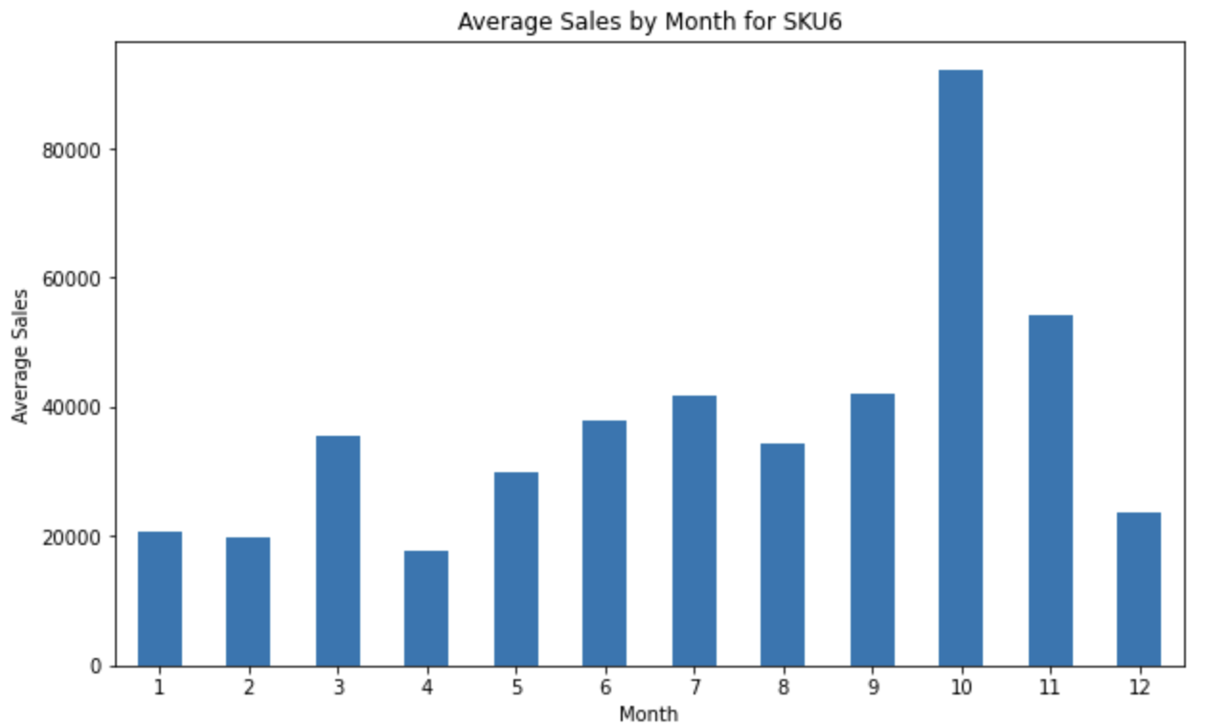
SKU6 Monthly Average Sales
The average sales of SKU6 is relatively low compared to the other products. In october, the sales spikes but drops in december, january, february and april.This indicates seasonality in product demand, however, marketing strategies should be implemented to improve overall sales.

Slide 13
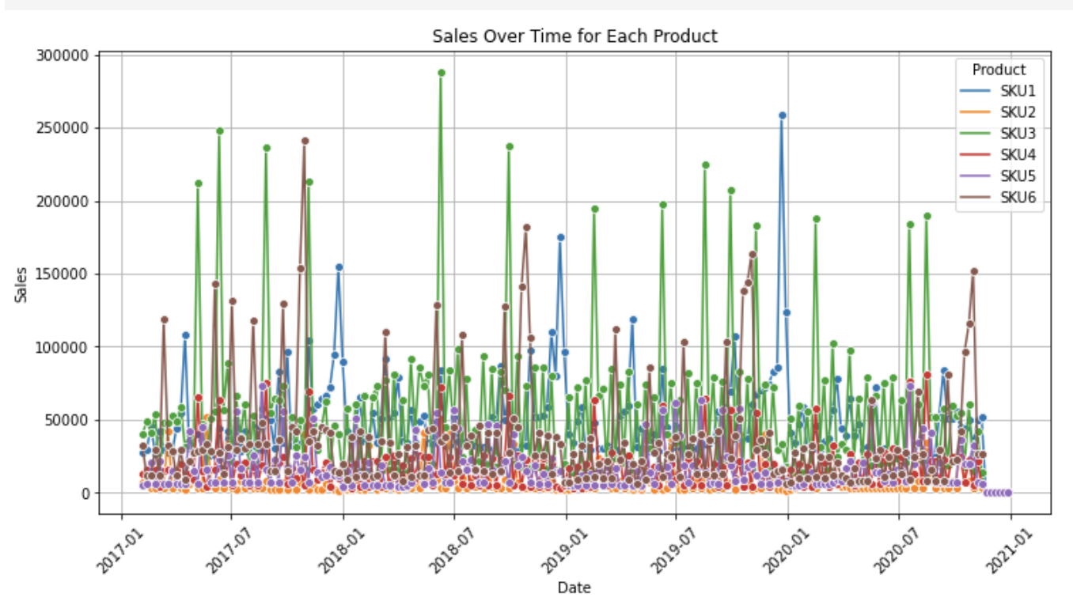
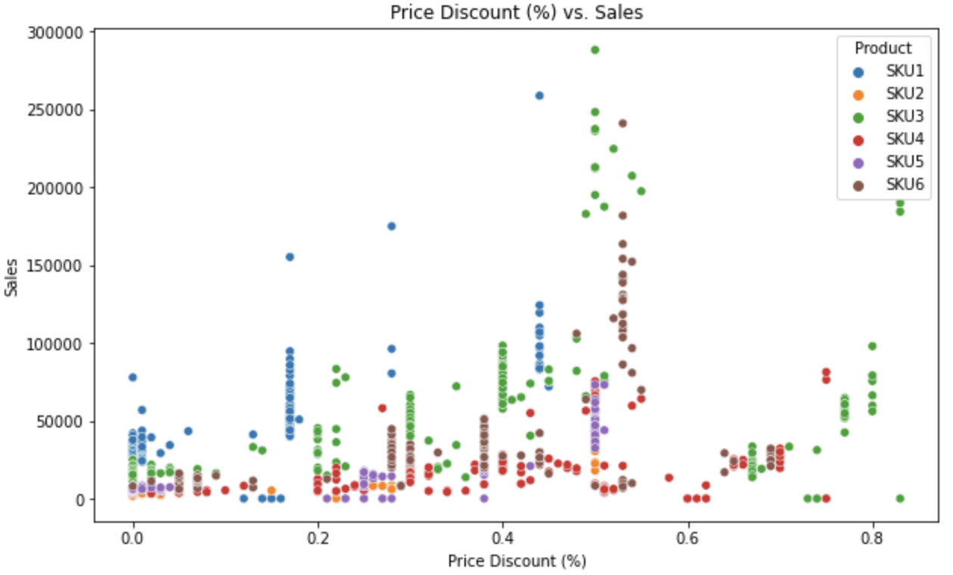
Sales Overtime and Impact of Price discount on Sales
Sku3, sku1 and Sku4 shows establishment in the market, however sku6, sku5 and sku1 needs more strategies increase sales. Some months, the sales are high and low in some months varying per product this shows seasonality in product demand.
Most of the products sales when the price discount is somewhere between 20% and 50%. sku3 and sku6 had the highest sales when the price discount was around 50%. Sku2 was slightly affected by price discount.

Slide 14
Model
Suggestions
Classical Models:
Linear Regression
Autoregressive Model (or ARMA Model) (https://www.turing.com/kb/guide-to-autoregressive-models)
Monte Carlo Method (https://www.oreilly.com/library/view/practical-time-series/9781492041641/ch04.html)
ML Models:
Ridge Regression (https://seralouk.medium.com/forecasting-timeseries-using-machine-learning-deep-learning-446eccc6eb6d)
Random Forest (https://www.analyticsvidhya.com/blog/2021/06/random-forest-for-time-series-forecasting/)
DL Models:
Linear Regression
Autoregressive Model (or ARMA Model) (https://www.turing.com/kb/guide-to-autoregressive-models)
Monte Carlo Method (https://www.oreilly.com/library/view/practical-time-series/9781492041641/ch04.html)

Slide 15
Model Selection
Model selection and Evaluation
In our analysis we tried different models:
Classical Models: We tried ARIMA and Linear regression; which gave us insights on how different features impacted the sales of each product.
Machine Learning models: We tried Random Forest, XGBoost; which captures more complex relationship in the data
Deep Learning Models: We tried LSTM, which detects more complicated data patterns

Slide 16
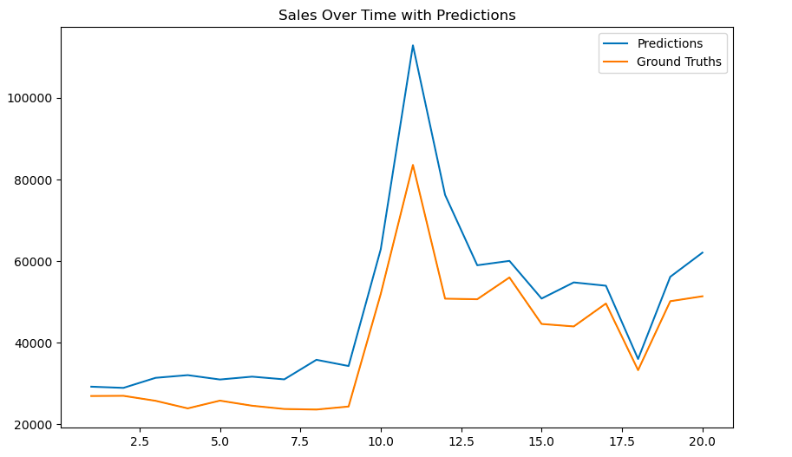
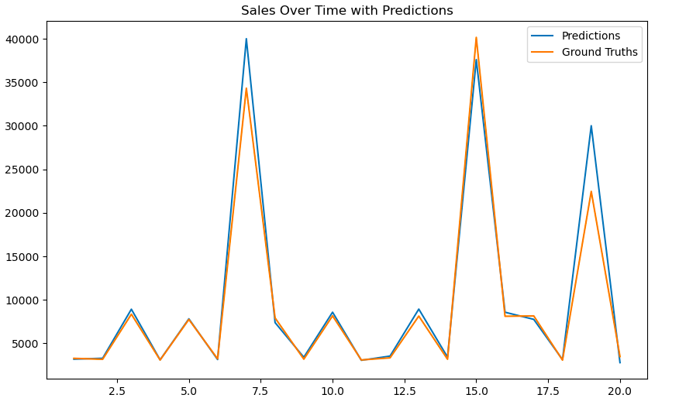
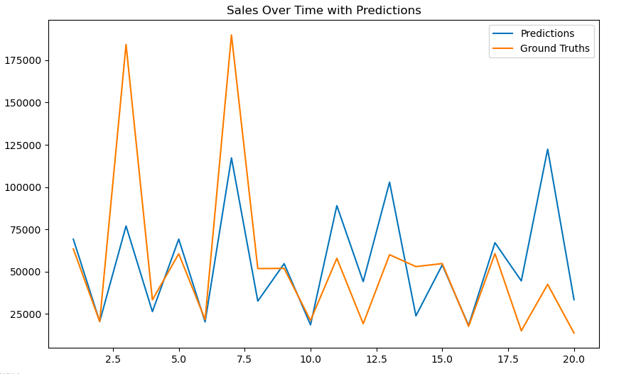
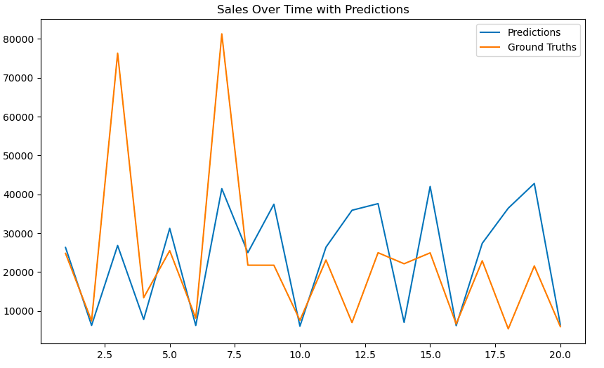
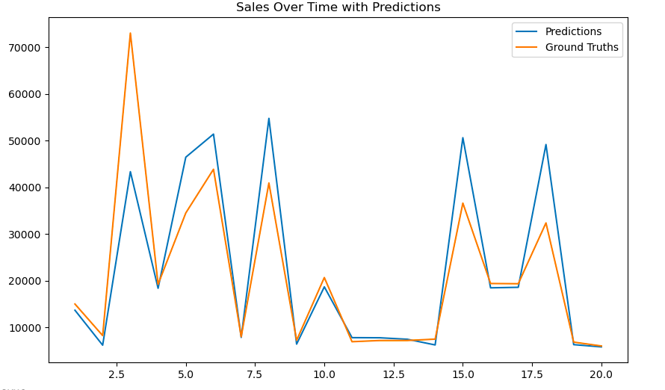
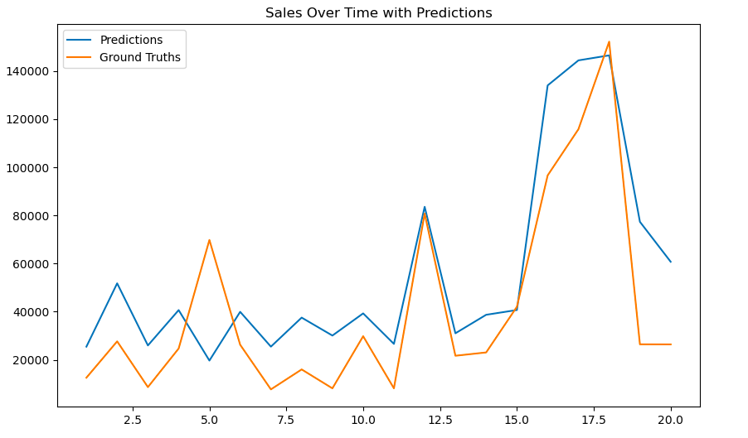
Result
(Random Forest)

Slide 17
Conclusion
Recommendation:
After testing and evaluating these models, we found that Machine Learning models are demonstrating the best performance. For some products, Random Forest generally performs better, and XGBoost is better for some SKUs. ARIMA performed well for only SKU 4 compared to other models.

Slide 18
Thank You

